Slide 1
Data Mining
(knowledge discovery from data: KDD)

Slide 2
Data mining is the process of extracting valuable, often non-obvious information from large datasets.
It involves techniques from statistics, database systems, and artificial intelligence to discover patterns, correlations, and insights that might not be apparent through traditional analysis methods.

Slide 3
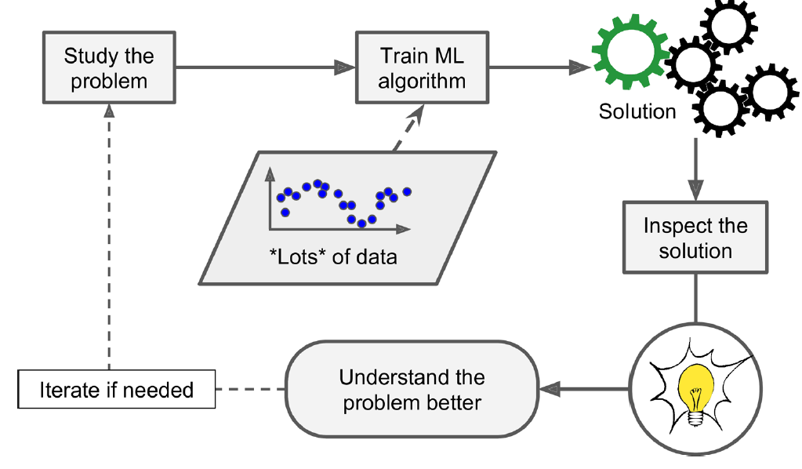
Machine Learning can help humans learn.
ML algorithms can be inspected to see what they have learned (although for some algorithms, this can be tricky).
For instance, once a spam filter has been trained on enough spam, it can easily be inspected to reveal the list of words and combinations of words that it believes are the best predictors of spam.
Sometimes this will reveal unsuspected correlations or new trends, and thereby lead to a better understanding of the problem.
Applying ML techniques to dig into large amounts of data can help discover patterns that were not immediately apparent. This is called data mining.

Slide 4
The data mining process consists of several steps that transform raw data into useful insights:
Data Collection: Gather data from various sources such as databases, spreadsheets, and web sources.
Data Preprocessing: Clean and preprocess data by handling missing values, duplicates, and noise.
Data Transformation: Convert data into an appropriate format for analysis (e.g., normalization, encoding categorical values).
Pattern Discovery: Apply data mining techniques such as classification, clustering etc to identify patterns.
Evaluation & Interpretation: Assess the discovered patterns for accuracy, relevance, and usefulness.
Deployment: Integrate the results into decision-making processes for practical use.

Slide 5
Major challenges involved in the data mining process
Handling Noisy and Incomplete Data
Missing values, duplicate records, and inconsistent data affect accuracy, which can be addressed by using data preprocessing techniques like imputation, data cleaning, and noise filtering.
Scalability and Efficiency
Large datasets require high computational power, where we can use distributed
computing and optimized algorithms.
Data Privacy and Security
Sensitive data (e.g., personal information) may be exposed. One can use
encryption, Anonymization, etc to address that issue.
4. Model Interpretability
Complex models (e.g., deep learning) are difficult to understand, where one can use explainable AI techniques like decision trees, etc, to understand the same.

Slide 6
Different types of data are associated with data mining process.
Structured Data (RDBMS) Structured data is organized into defined fields such as rows and columns. It is usually stored in relational databases or spreadsheets with a clear schema. (Using SQL lot of insights could be derived)
Unstructured data (WWW,Text documents, emails, social media posts, and web pages) does not follow a specific format or structure.
Preprocessing unstructured data generally involves natural language processing (NLP) for text, or computer vision techniques for images and videos.
Semi-structured data (JSON files, NoSQL databases)
Semi-structured data falls between structured and unstructured data. It doesn't conform to a rigid tabular format but contains tags, markers, or other elements that provide some level of organization and hierarchy, making it easier to analyze than purely unstructured data.

Slide 7
Similarity and dissimilarity measures are fundamental tools used to quantify the resemblance or difference between data objects. These measures are crucial for various data mining tasks, including:
Clustering: Grouping similar data objects together.
Classification: Assigning new data objects to predefined categories based on their similarity to existing labeled objects.
Anomaly Detection: Identifying data objects that are significantly dissimilar from the rest of the data.
Recommendation Systems: Finding items similar to those a user has liked or interacted with.
Information Retrieval: Finding documents or items similar to a query.

Slide 8
Similarity Measures (higher value means similar) and Dissimilarity Measures (Higher value means Dissimilar)
Manhattan distance (logistics, routing algorithms, robustness to outliers(if you need to work like outliers don’t skew your analysis, sparse data)
Euclidean Distance (Same scaling, independent features: works well; only the distance between two points: not bothered about how the rest of the points in the dataset vary)
MahalaNobis Distance (is a measure of the distance between a point and a distribution, taking into account the covariance structure of the data.)
Hamming distance, for two strings of equal length, it's the number of positions at which the corresponding symbols are different. (DNA sequence matching)
Levenshtein distance measures the difference between two strings. It is the minimum number of single-character edits required to change one word into the other. (insertion, deletion, and substitutions. The distance between (hut and hat is 1, Sunday and Friday is 3, distance between cat and cats is 1)

Slide 9

Pearson’s Correlation Coefficient ( Correlation between variables X and Y), range (-1,1)
Cosine similarity (sentence completion, similar words, Word to vec embedding)
Kernel functions in SVM. (In vector spaces, the inner product (or dot product) is a measure of the projection of one vector onto another. A higher inner product generally indicates that the vectors are more aligned, which can be interpreted as them being more "similar" in that space.) Choosing an appropriate kernel, you are telling the SVM how to determine which data points are "close" or "similar" to each other in a way that helps to find the optimal separating hyperplane.

Slide 10
Classification of data mining systems based on different criteria.
Based on the kind of knowledge or data that is mined.
Transactional data mining (e.g., customer purchases).
Multimedia data mining (e.g., image recognition).
Web data mining (e.g., user behavior analysis).
Based on Techniques Used:
Machine Learning-based (e.g., decision trees, neural networks).
Statistical-based (e.g., regression).
Database-based (e.g., association rule mining).
Based on Application Area:
Business Intelligence (e.g., sales forecasting).
Scientific Research (e.g., medical diagnosis).
Cybersecurity (e.g., intrusion detection).

Slide 11
Data Mining Task Primitives are the basic building blocks or fundamental operations that help define a data mining task clearly.

Slide 12
Goal: Predict whether a customer will churn based on age, usage, and payment history
Data mining task Primitives Classification Example
Set Task-relevant data
Kind of knowledge to mine
Background knowledge
Interestingness measure
Pattern representation

Slide 13
Goal: Predict whether a customer will churn based on age, usage, and payment history
Data mining task Primitives Classification Example
Set Task-relevant data Customer(age, usage, bill_amt, churn)
Kind of knowledge to mine
Background knowledge
Interestingness measure
Pattern representation

Slide 14
Goal: Predict whether a customer will churn based on age, usage, and payment history
Data mining task Primitives Classification Example
Set Task-relevant data Customer(age, usage, bill_amt, churn)
Kind of knowledge to mine Classification (build a model to predict "churn" = yes/no)
Background knowledge
Interestingness measure
Pattern representation

Slide 15
Goal: Predict whether a customer will churn based on age, usage, and payment history
Data mining task Primitives Classification Example
Set Task-relevant data Customer(age, usage, bill_amt, churn)
Kind of knowledge to mine Classification (build a model to predict "churn" = yes/no)
Background knowledge Churn categories, domain knowledge
This knowledge about the domain to be mined is useful for guiding the knowledge discovery process and for evaluating the patterns found.
Interestingness measure
Pattern representation

Slide 16
Goal: Predict whether a customer will churn based on age, usage, and payment history
Data mining task Primitives Classification Example
Set Task-relevant data Customer(age, usage, bill_amt, churn)
Kind of knowledge to mine Classification (build a model to predict "churn" = yes/no)
Background knowledge Churn categories, domain knowledge
This knowledge about the domain to be mined is useful for guiding the knowledge discovery process and for evaluating the patterns found.
Interestingness measure Accuracy ≥ 80%, Gini index
To evaluate the discovered patterns
Pattern representation

Slide 17
Goal: Predict whether a customer will churn based on age, usage, and payment history
Data mining task Primitives Classification Example
Set Task-relevant data Customer(age, usage, bill_amt, churn)
Kind of knowledge to mine Classification (build a model to predict "churn" = yes/no)
Background knowledge Churn categories, domain knowledge
This knowledge about the domain to be mined is useful for guiding the knowledge discovery process and for evaluating the patterns found.
Interestingness measure Accuracy ≥ 80%, Gini index
To evaluate the discovered patterns
Pattern representation Tables, Decision trees, graphs etc.
This refers to the form in which discovered patterns are to be displayed

